Slide 1


Embedded Systems Design
Chapter 12: Introduction to Timers
12.1 Timer Overview
Brock J. LaMeres, Ph.D.

Slide 2
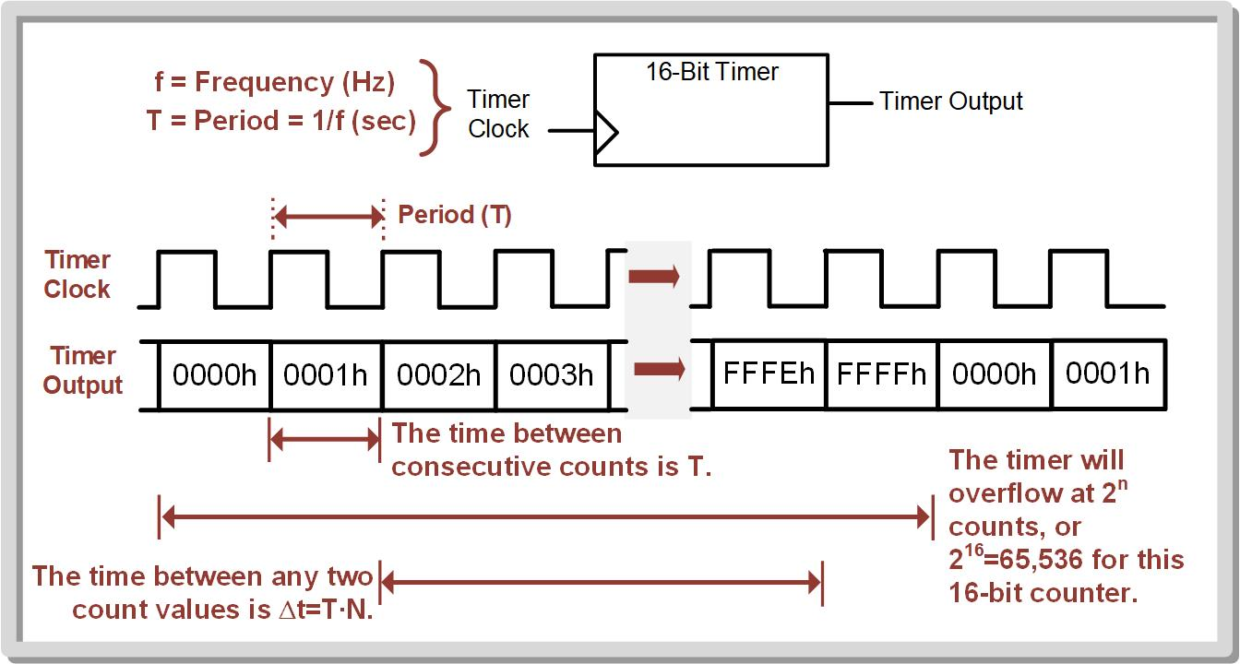
Ch. 12: Introduction to Timers
12.1 Timer Overview
Timer – a binary counter that is clocked from a free-running clock with a known frequency.
The time elapsed can be found by multiplying the period of the clock (T = 1/f) by the number of counts that have occurred (N). Time elapsed (∆t) = T * N
12.1 Timer Overview

Slide 3
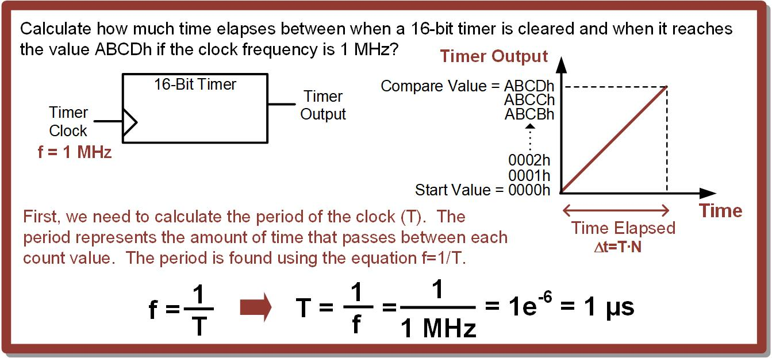
Ch. 12: Introduction to Timers
Example: Calculating the Time Elapsed Between 0000h and ABCDh
12.1 Timer Overview

Slide 4
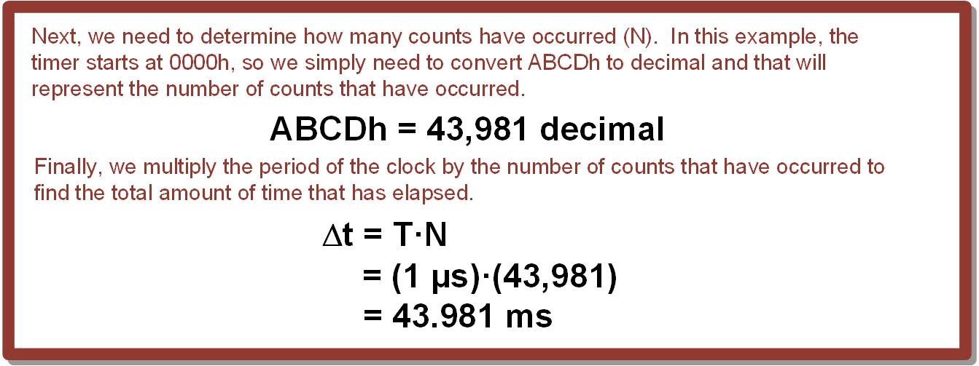
Ch. 12: Introduction to Timers
Example: Calculating the Time Elapsed Between 0000h and ABCDh
12.1 Timer Overview

Slide 5
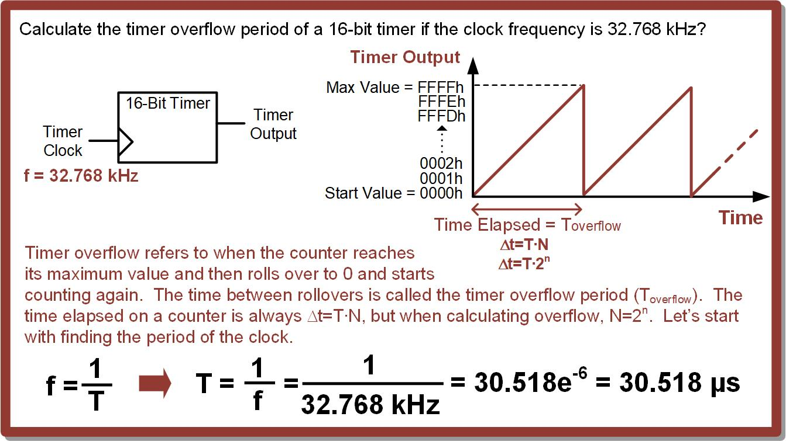
Ch. 12: Introduction to Timers
12.1 Timer Overview
Timer Overflow Period (T_{overflow}) – the amount of time between when a timer starts at 0 and when it reaches its maximum value and rolls over back to 0.
∆t = T * N
N = 2^{n}
12.1 Timer Overview

Slide 6
Ch. 12: Introduction to Timers
Example: Calculating the Timer Overflow Period
12.1 Timer Overview

Slide 7
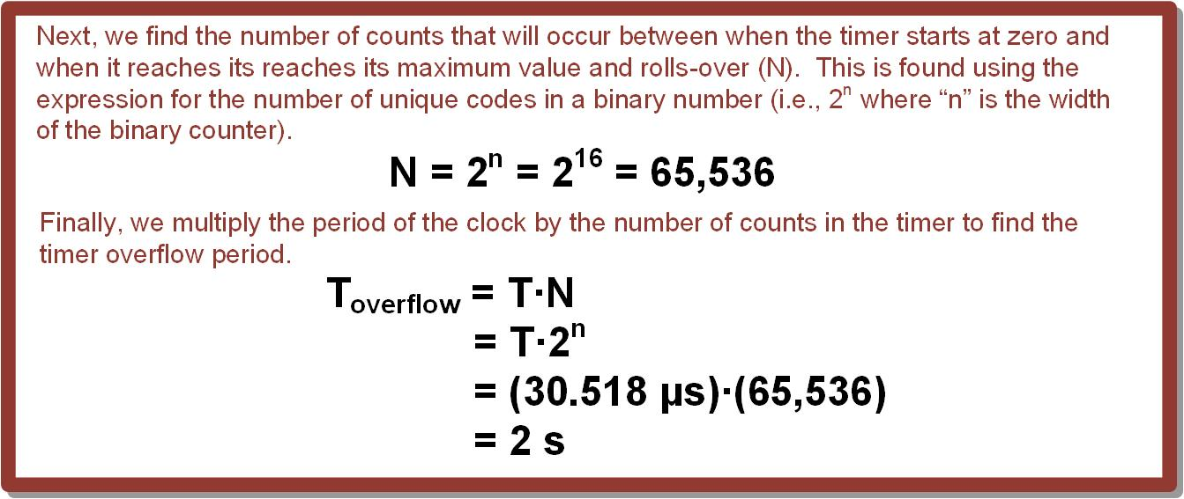
Ch. 12: Introduction to Timers
Example: Calculating the Timer Overflow Period
12.1 Timer Overview

Slide 8
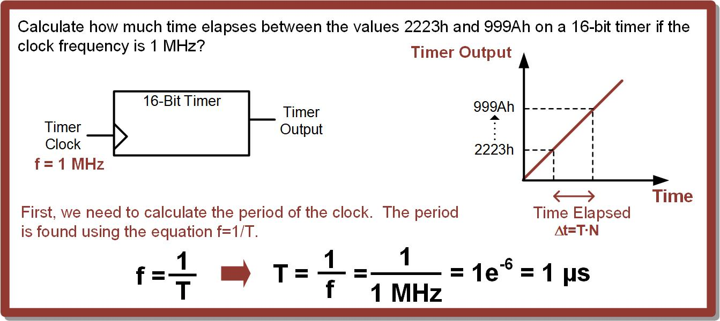
Ch. 12: Introduction to Timers
Example: Calculating the Time Elapsed Between 2223h and 999Ah
12.1 Timer Overview

Slide 9
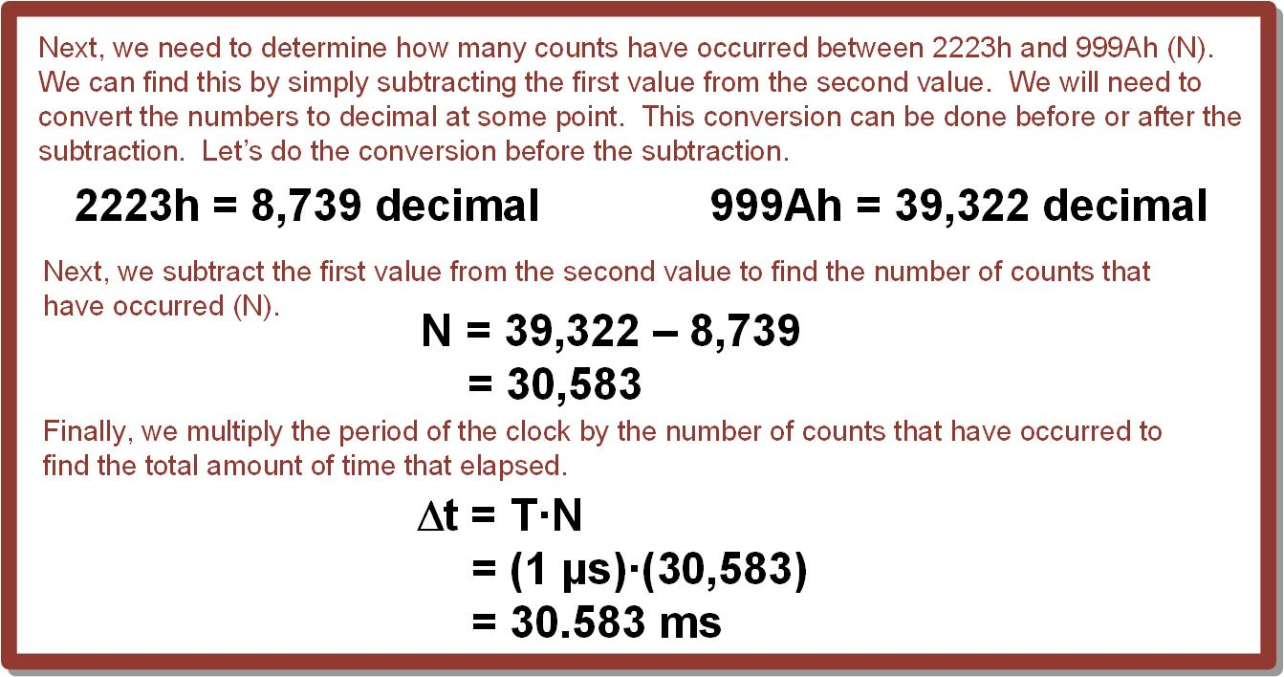
Ch. 12: Introduction to Timers
Example: Calculating the Time Elapsed Between 2223h and 999Ah
12.1 Timer Overview

Slide 10
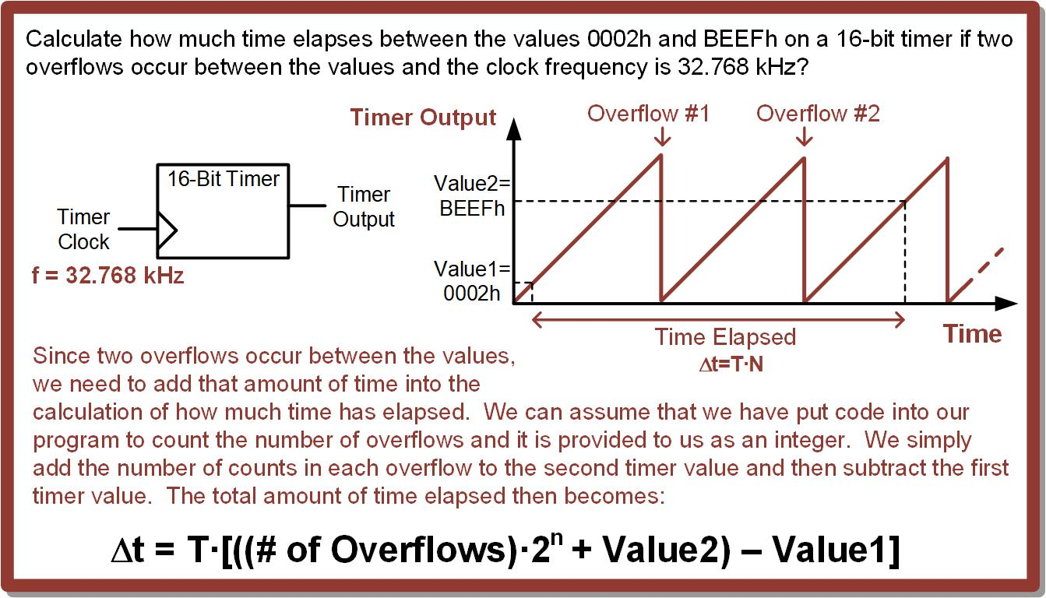
Ch. 12: Introduction to Timers
12.1 Timer Overview
Often when tracking the time elapsed between two external events with a timer, there can be multiple timer overflows between the events.
This means that we must account for the additional time beyond simply subtracting two specific timer values.
12.1 Timer Overview

Slide 11
Ch. 12: Introduction to Timers
Example: Calculating the Time Between Values with Overflows
12.1 Timer Overview

Slide 12
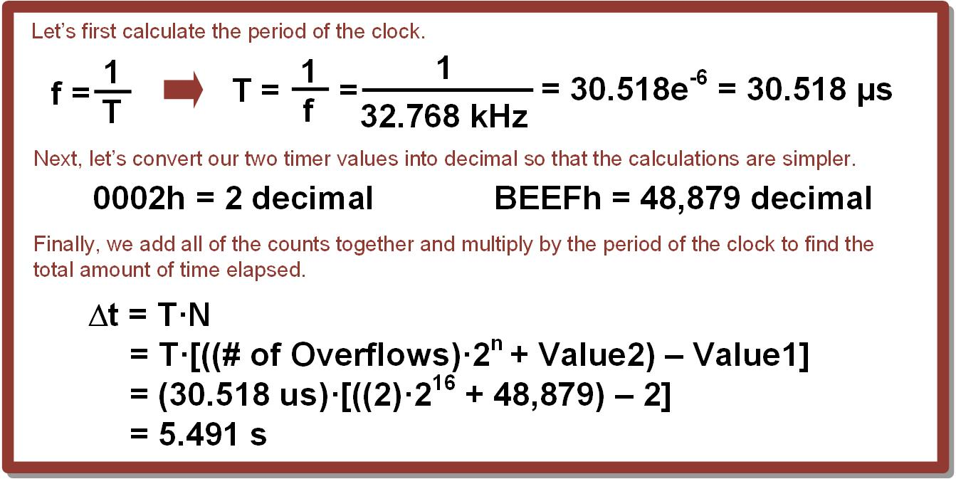
Ch. 12: Introduction to Timers
Example: Calculating the Time Between Values with Overflows
12.1 Timer Overview

Slide 13

Embedded Systems Design
Chapter 12: Introduction to Timers
12.1 Timer Overview
www.youtube.com/c/DigitalLogicProgramming_LaMeres
Brock J. LaMeres, Ph.D.

Slide 14
Embedded Systems Design
Chapter 12: Introduction to Timers
12.2 Timer Overflows on the MSP430FR2355 – System Overview
Brock J. LaMeres, Ph.D.

Slide 15
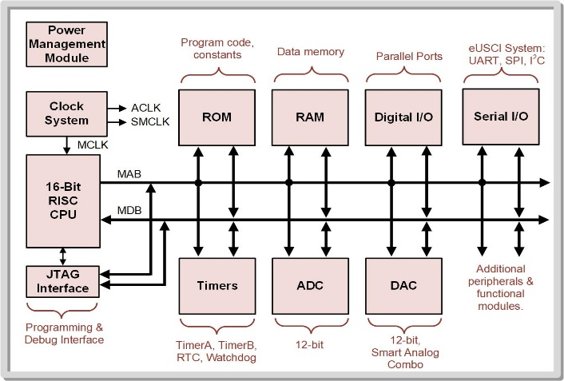
Ch. 12: Introduction to Timers
12.2 Timers on the MSP430
MSP430 architecture contains the following timer sub-systems: Timer_A, Timer_B, real-time clock counter (RTC), and Watchdog counter.
12.1 Timer Overview

Slide 16
Ch. 12: Introduction to Timers
12.2 Timers on the MSP430
Timer_A and Timer_B:
have multiple, independent binary counters that provide separate timing capability.
Each timer can generate interrupts when its value either matches a value placed into a compare register, or when it overflows.
12.1 Timer Overview

Slide 17
Ch. 12: Introduction to Timers
12.2 Timers on the MSP430
Timer_A and Timer_B:
have multiple, independent binary counters that provide separate timing capability.
Each timer can generate interrupts when its value either matches a value placed into a compare register, or when it overflows.
The MSP430FR2355 does NOT implement the Timer A system
This chapter only focuses on Timer_B.
12.1 Timer Overview

Slide 18
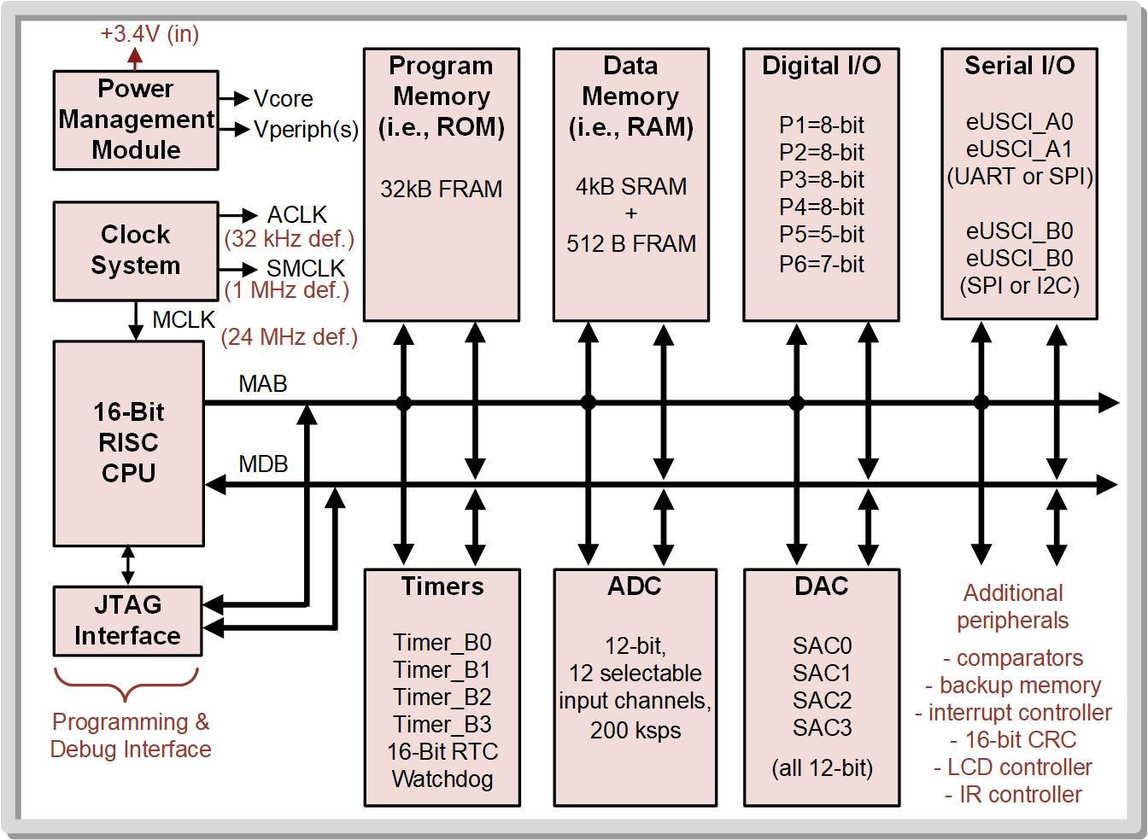
Ch. 12: Introduction to Timers
12.2 Timers on the MSP430FR2355
The MSP430FR2355 Timer_B system provides four independent timers – TB0, TB1, TB2, and TB3.
12.2 Timer Overflows on the MSP430FR2355

Slide 19
Ch. 12: Introduction to Timers
12.2 Timers on the MSP430FR2355
The MSP430FR2355 Timer_B system provides four independent timers – TB0, TB1, TB2, and TB3.
Timers TB0, TB1, and TB2 each have three capture/compare registers associated with them – Timer0_B3, Timer1_B3, and Timer2_B3.
Timer TB3 has seven capture/compare registers so it is often referred to as Timer3_B7.
12.2 Timer Overflows on the MSP430FR2355

Slide 20
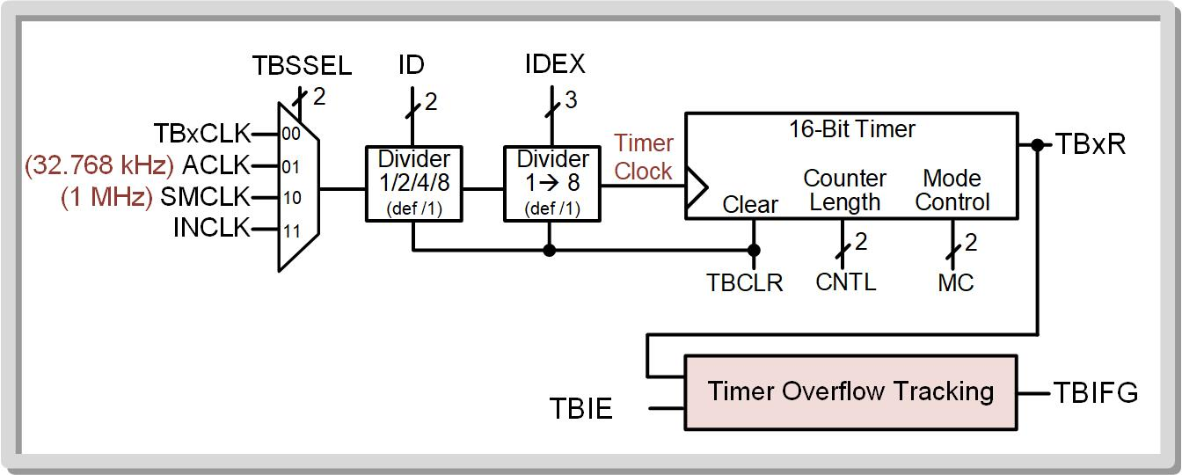
Ch. 12: Introduction to Timers
12.2 Timer Overflows on the MSP430FR2355
12.2 Timer Overflows on the MSP430FR2355

Slide 21
Ch. 12: Introduction to Timers
12.2 Timer Overflows on the MSP430FR2355
The Timer_B system has a 16_bit binary counter which has a variety of settings that are controlled by the user.
12.2 Timer Overflows on the MSP430FR2355

Slide 22
Ch. 12: Introduction to Timers
12.2 Timer Overflows on the MSP430FR2355
Each timer has selectable clock inputs and the ability to divide down the clock to get slower counting frequencies.
Types of clock sources: ACLK (32.768 kHz) and SMCLK (1 MHz).
12.2 Timer Overflows on the MSP430FR2355

Slide 23
Ch. 12: Introduction to Timers
12.2 Timer Overflows on the MSP430FR2355
A first stage clock divider (ID) can divide the clock by 1, 2, 4, and 8.
A second stage clock divider (IDEX) can further divide the clock by 1, 2, 3, 4, 5, 6, 7, and 8.
This gives 32 different divider settings (min=1, max=64).
12.2 Timer Overflows on the MSP430FR2355

Slide 24
Ch. 12: Introduction to Timers
12.2 Timer Overflows on the MSP430FR2355
The counter length can be changed using CNTL (8, 10, 12, 16 bits)
12.2 Timer Overflows on the MSP430FR2355

Slide 25
Ch. 12: Introduction to Timers
12.2 Timer Overflows on the MSP430FR2355
The counting mode can be changed using MC (Up, Continuous, Up/Down).
Continuous counting mode - counts up to its maximum value and then rolls-over to 0.
In this mode, a roll-over (2^{n}) can generate an interrupt.
12.2 Timer Overflows on the MSP430FR2355

Slide 26
Ch. 12: Introduction to Timers
12.2 Timer Overflows on the MSP430FR2355
Recommended Steps to Configure the Timer
Write a 1 to the TBCLR bit (TBCLR = 1) to clear TBxR, the clock divider states, and the counter direction.
Apply desired configurations to TBxCTL.
12.2 Timer Overflows on the MSP430FR2355

Slide 27
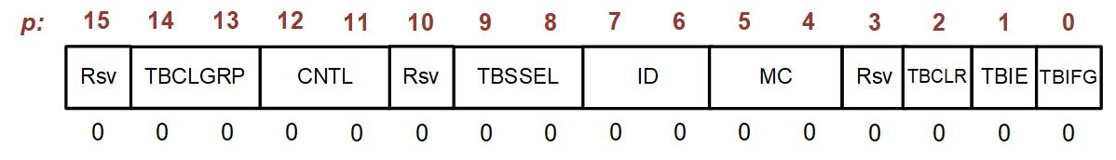
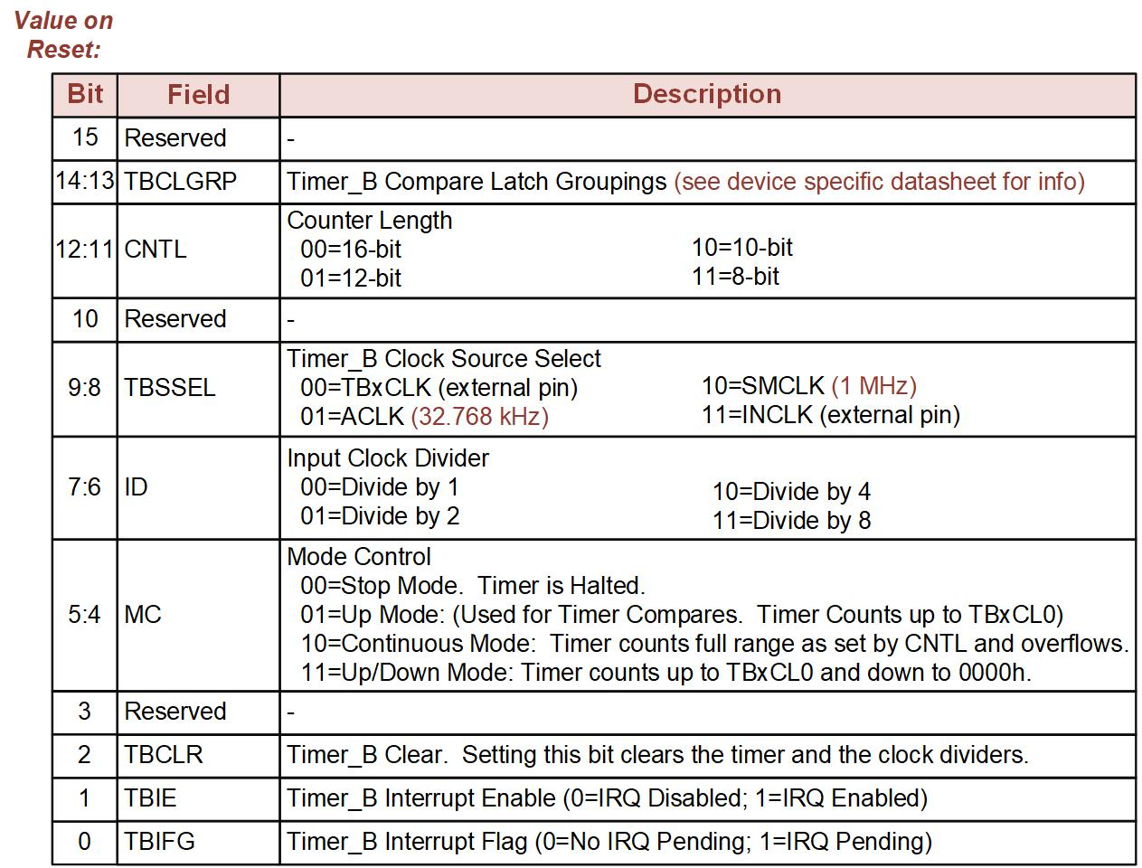
Ch. 12: Introduction to Timers
12.2 Timer_B Control Register (TBxCTL)
12.2 Timer Overflows on the MSP430FR2355

Slide 28
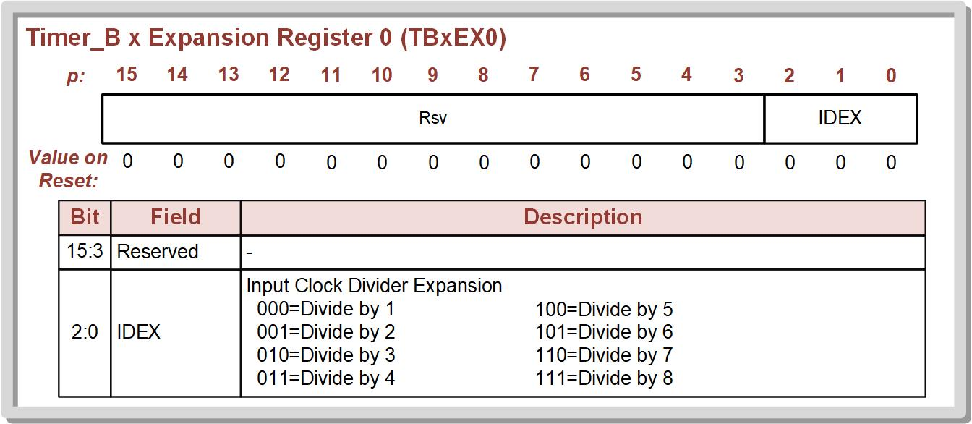
Ch. 12: Introduction to Timers
12.2 Timer_B Expansion Register 0 (TBxEX0) Details
12.2 Timer Overflows on the MSP430FR2355

Slide 29
Ch. 12: Introduction to Timers
12.2 Timer Overflows on the MSP430FR2355
Using the overflow interrupt
Flag = TBIFG bit in TBxCTL register.
Local Enable = TBIE bit in TBxCTL register.
Global Enable = GIE bit in SR.
12.2 Timer Overflows on the MSP430FR2355

Slide 30
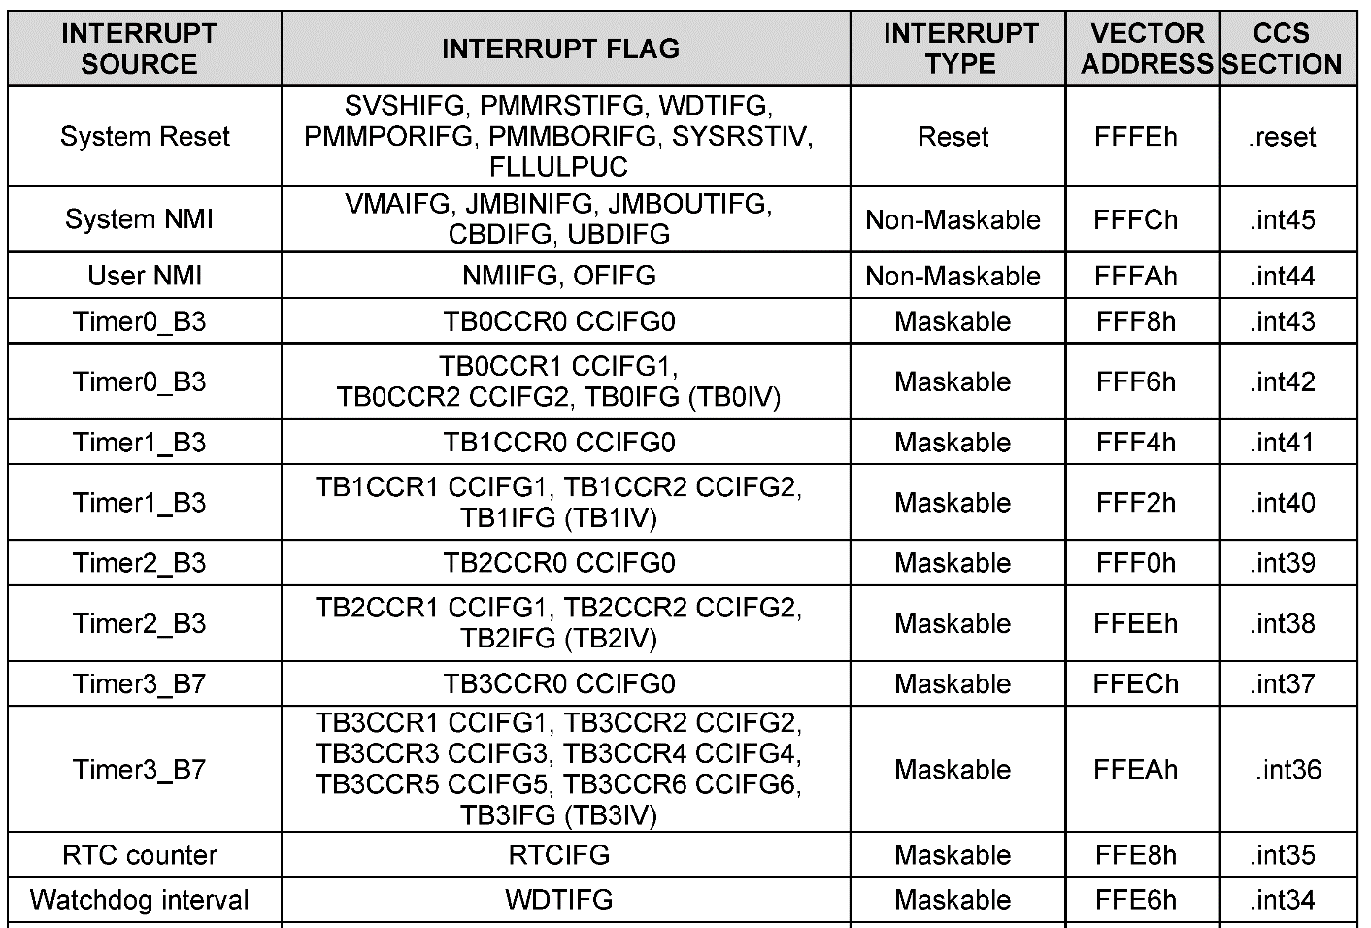
Ch. 12: Introduction to Timers
12.2 Timer Overflows on the MSP430FR2355
12.2 Timer Overflows on the MSP430FR2355

Slide 31
Embedded Systems Design
Chapter 12: Introduction to Timers
12.2 Timer Overflows on the MSP430FR2355 – System Overview
www.youtube.com/c/DigitalLogicProgramming_LaMeres
Brock J. LaMeres, Ph.D.

Slide 32
Embedded Systems Design
Chapter 12: Introduction to Timers
12.2 Timer Overflows on the MSP430FR2355: Example – Toggling LED1 on Timer Overflow (ACLK)
Brock J. LaMeres, Ph.D.

Slide 33
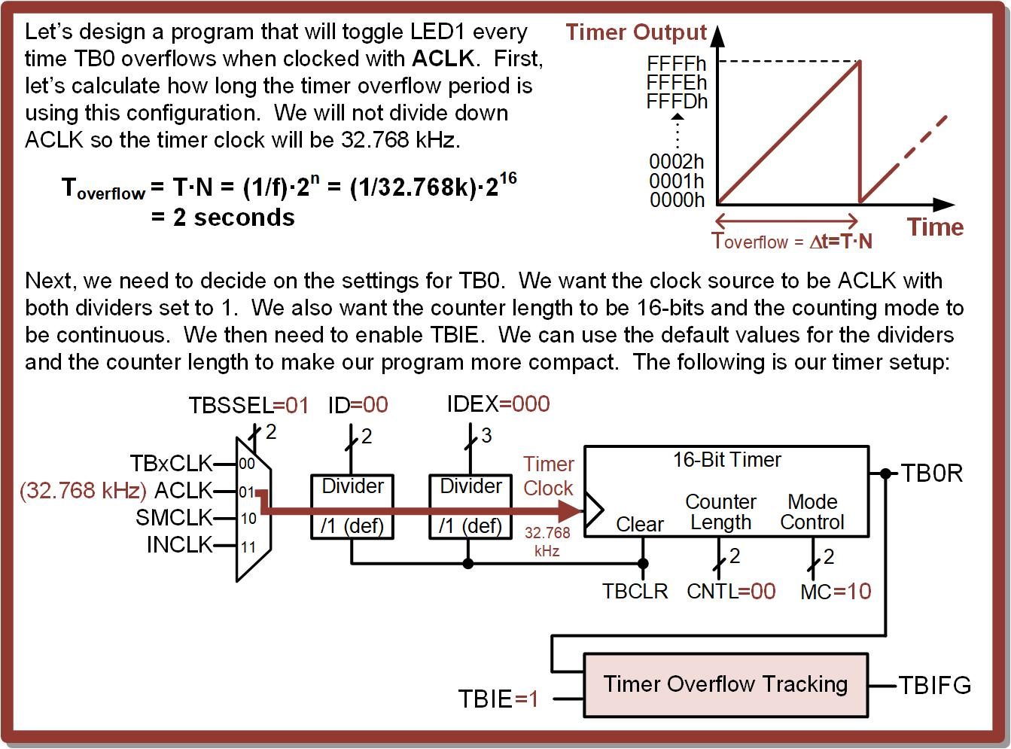
Ch. 12: Introduction to Timers
Ex: Toggling LED1 on TB0 Overflow Using ACLK
12.2 Timer Overflows on the MSP430FR2355

Slide 34

Ch. 12: Introduction to Timers
Ex: Toggling LED1 on TB0 Overflow Using ACLK
Step 1: Create a new Empty Assembly-only CCS project titled:
Asm_Timers_ACLK_Overflow
Step 2: Type in the following code into the main.asm file where the comments say “Main loop here.”
Image Courtesy of https://neodem.wp.horizon.ac.uk/
Image Courtesy of
Recording Connection of Canada
Image Courtesy of
Recording Connection of Canada
Image Courtesy of
Recording Connection of Canada
Image Courtesy of
Recording Connection of Canada
12.2 Timer Overflows on the MSP430FR2355

Slide 35
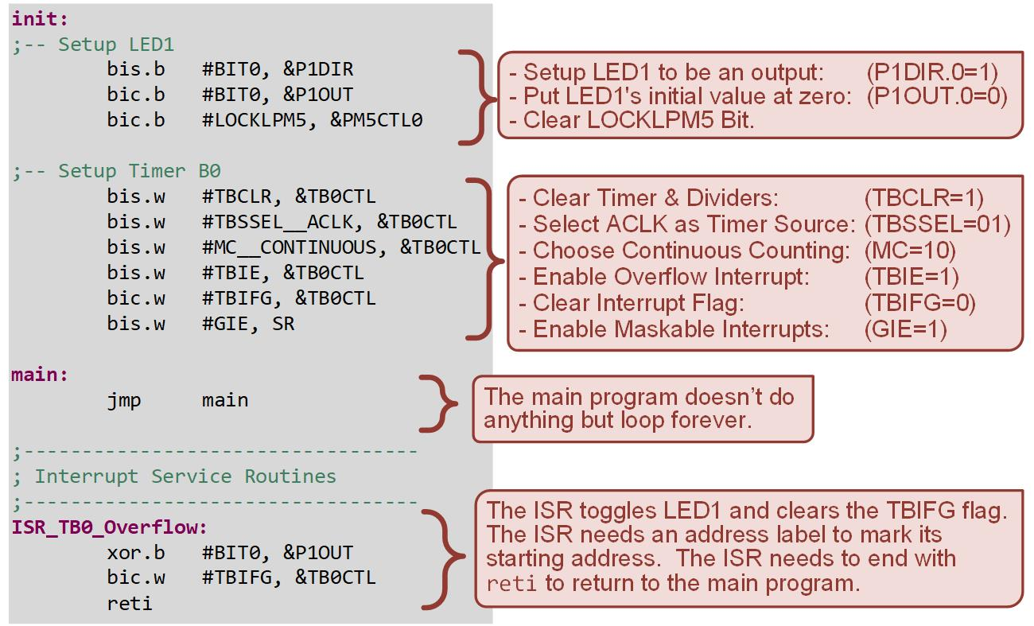
Ch. 12: Introduction to Timers
Ex: Toggling LED1 on TB0 Overflow Using ACLK
12.2 Timer Overflows on the MSP430FR2355

Slide 36
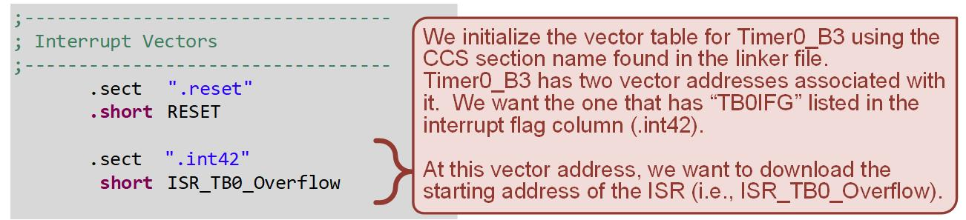
Ch. 12: Introduction to Timers
Ex: Toggling LED1 on TB0 Overflow Using ACLK
Step 3: Debug your program and run it. You will see LED1 toggle on and off every two seconds.
12.2 Timer Overflows on the MSP430FR2355

Slide 37
Embedded Systems Design
Chapter 12: Introduction to Timers
12.2 Timer Overflows on the MSP430FR2355: Example – Toggling LED1 on Timer Overflow (ACLK)
www.youtube.com/c/DigitalLogicProgramming_LaMeres
Brock J. LaMeres, Ph.D.

Slide 38
Embedded Systems Design
Chapter 12: Introduction to Timers
12.2 Timer Overflows on the MSP430FR2355: Example – Toggling LED1 on Timer Overflow (ACLK, 12-bit)
Brock J. LaMeres, Ph.D.

Slide 39
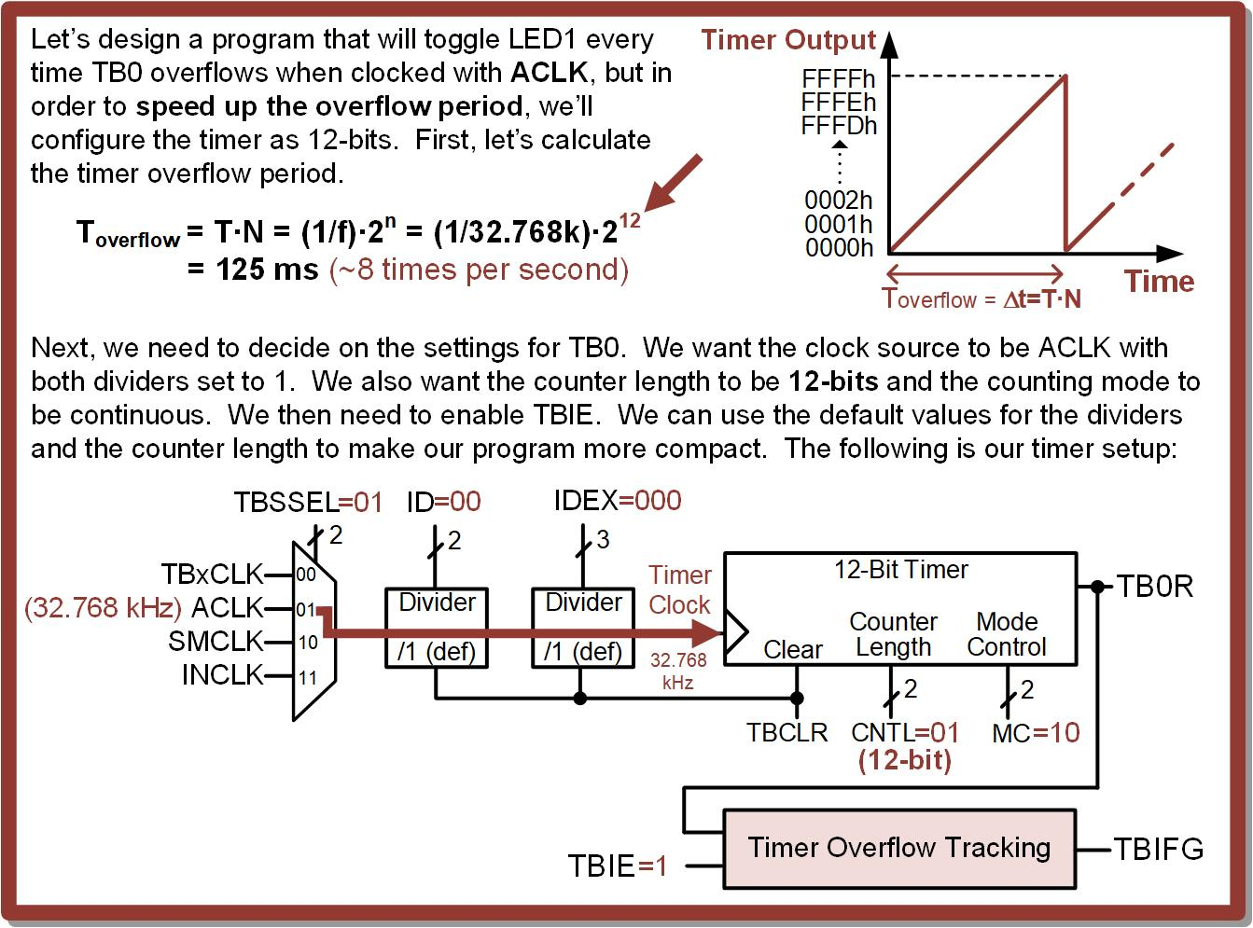
Ch. 12: Introduction to Timers
12.2 Timer Overflows on the MSP430FR2355

Slide 40
Ch. 12: Introduction to Timers
Ex: Toggling LED1 on TB0 Overflow Using ACLK and a 12-bit Counter Config
Step 1: Create a new Empty Assembly-only CCS project titled:
Asm_Timers_ACLK_Overflow_12bit
Step 2: Type in the following code into the main.asm file where the comments say “Main loop here.” This is the same as the last ACLK example with one additional instruction to configure CNTL.
Image Courtesy of https://neodem.wp.horizon.ac.uk/
12.2 Timer Overflows on the MSP430FR2355

Slide 41
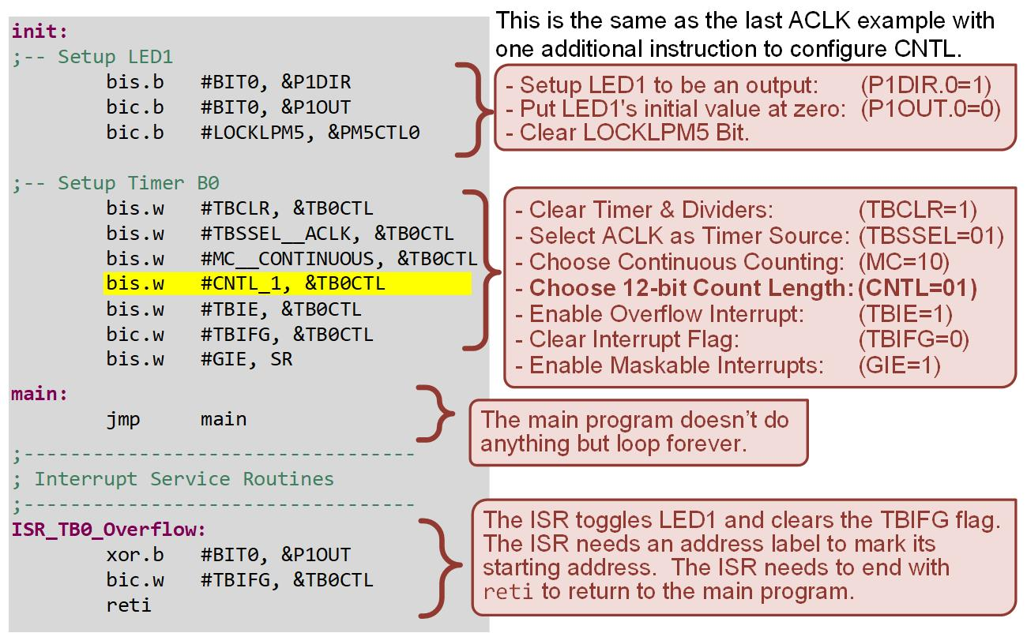
Ch. 12: Introduction to Timers
Ex: Toggling LED1 on TB0 Overflow Using ACLK
12.2 Timer Overflows on the MSP430FR2355

Slide 42
Ch. 12: Introduction to Timers
Ex: Toggling LED1 on TB0 Overflow Using ACLK
Step 3: Debug your program and run it. You will see LED1 toggle on and off every 125 ms.
12.2 Timer Overflows on the MSP430FR2355

Slide 43
Embedded Systems Design
Chapter 12: Introduction to Timers
12.2 Timer Overflows on the MSP430FR2355: Example – Toggling LED1 on Timer Overflow (ACLK, 12-bit)
www.youtube.com/c/DigitalLogicProgramming_LaMeres
Brock J. LaMeres, Ph.D.

Slide 44
Embedded Systems Design
Chapter 12: Introduction to Timers
12.2 Timer Overflows on the MSP430FR2355: Example – Toggling LED1 on Timer Overflow (SMCLK)
Brock J. LaMeres, Ph.D.

Slide 45
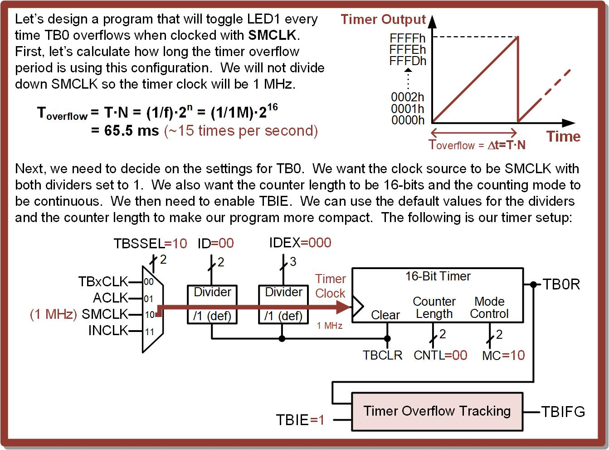
Ch. 12: Introduction to Timers
12.2 Timer Overflows on the MSP430FR2355

Slide 46
Ch. 12: Introduction to Timers
Ex: Toggling LED1 on TB0 Overflow Using SMCLK
Step 1: Create a new Empty Assembly-only CCS project titled:
Asm_Timers_SMCLK_Overflow
Step 2: Type in the following code into the main.asm file where the comments say “Main loop here.”
Image Courtesy of https://neodem.wp.horizon.ac.uk/
12.2 Timer Overflows on the MSP430FR2355

Slide 47
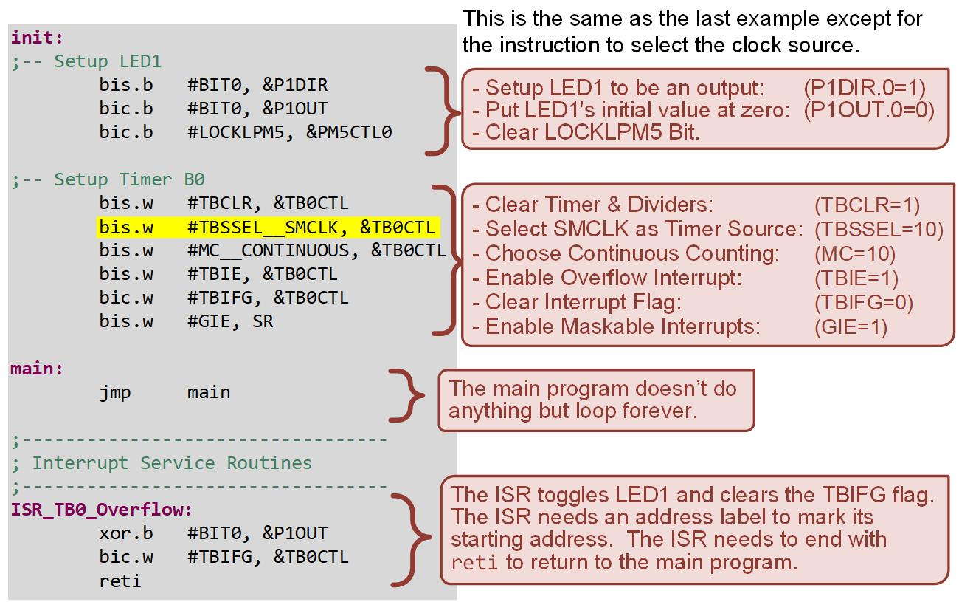
Ch. 12: Introduction to Timers
Ex: Toggling LED1 on TB0 Overflow Using SMCLK
12.2 Timer Overflows on the MSP430FR2355

Slide 48
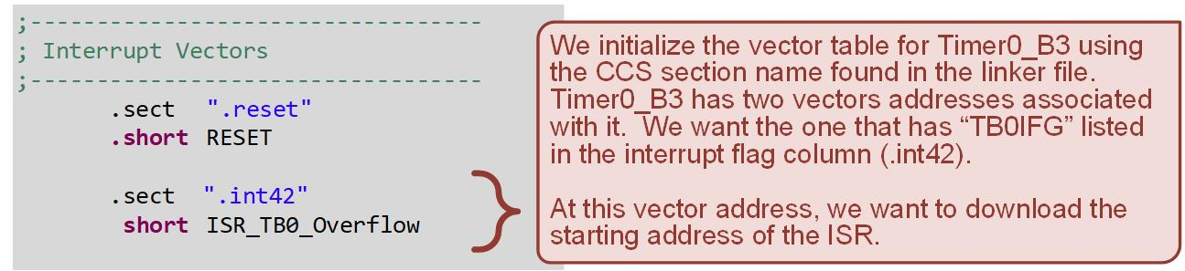
Ch. 12: Introduction to Timers
Ex: Toggling LED1 on TB0 Overflow Using SMCLK
Step 3: Debug your program and run it. You will see LED1 toggle on and off every 65.5 ms.
12.2 Timer Overflows on the MSP430FR2355

Slide 49
Embedded Systems Design
Chapter 12: Introduction to Timers
12.2 Timer Overflows on the MSP430FR2355: Example – Toggling LED1 on Timer Overflow (SMCLK)
www.youtube.com/c/DigitalLogicProgramming_LaMeres
Brock J. LaMeres, Ph.D.

Slide 50
Embedded Systems Design
Chapter 12: Introduction to Timers
12.2 Timer Overflows on the MSP430FR2355: Example – Toggling LED1 on Timer Overflow (SMCLK, Div4)
Brock J. LaMeres, Ph.D.

Slide 51
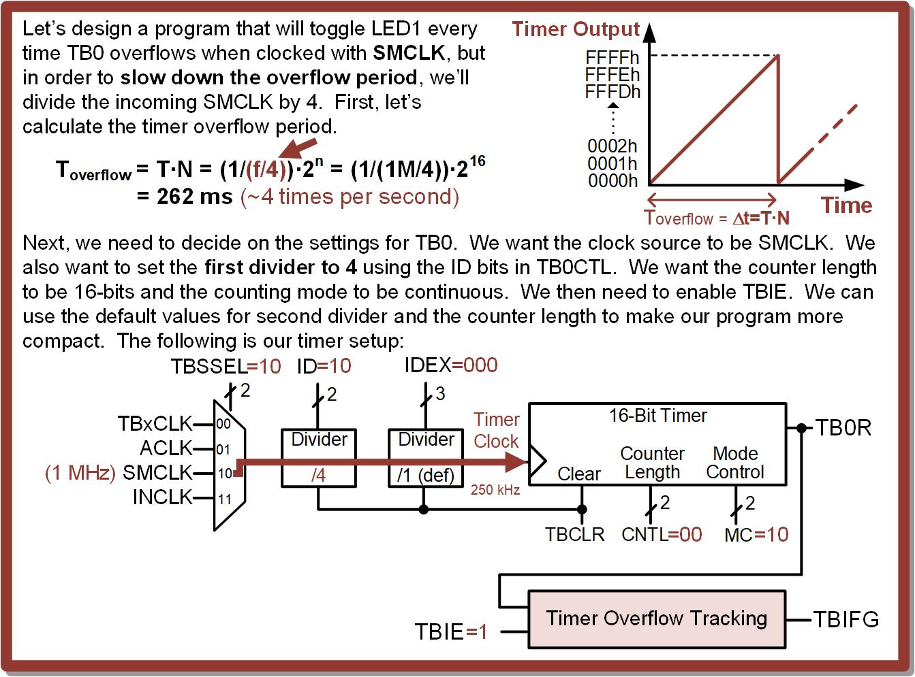
Ch. 12: Introduction to Timers
12.2 Timer Overflows on the MSP430FR2355

Slide 52
Ch. 12: Introduction to Timers
Ex: Toggling LED1 on TB0 Overflow Using SMCLK and a Divide-by-4 Clock Config
Step 1: Create a new Empty Assembly-only CCS project titled:
Asm_Timers_SMCLK_Overflow_Div4
Step 2: Type in the following code into the main.asm file where the comments say “Main loop here.”
Image Courtesy of https://neodem.wp.horizon.ac.uk/
12.2 Timer Overflows on the MSP430FR2355

Slide 53
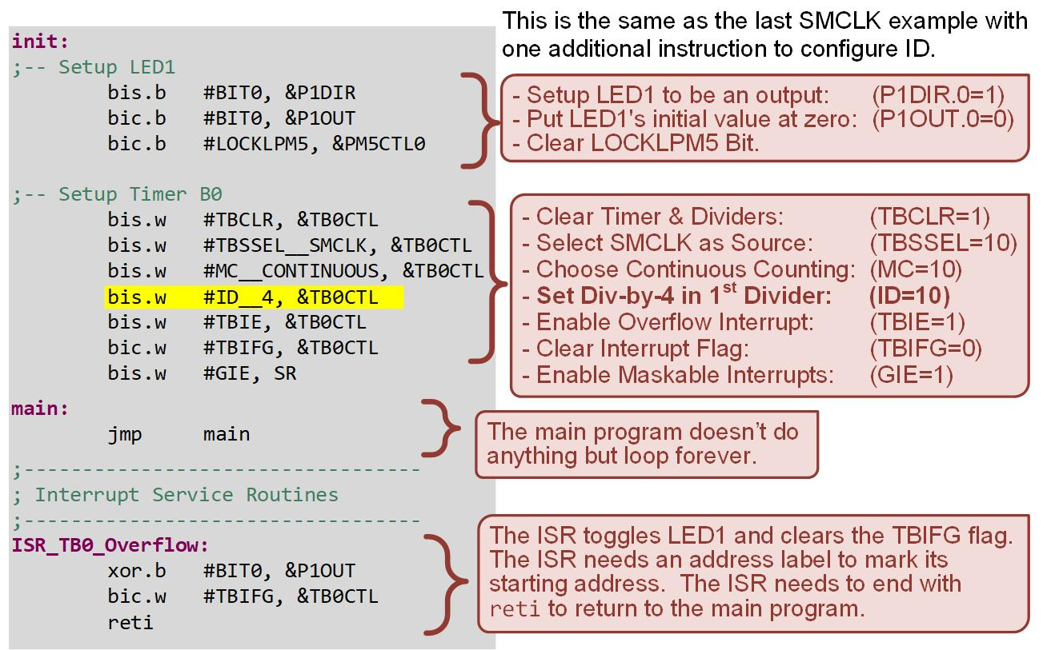
Ch. 12: Introduction to Timers
Ex: Toggling LED1 on TB0 Overflow Using SMCLK and a Divide-by-4 Clock Config
12.2 Timer Overflows on the MSP430FR2355

Slide 54
Ch. 12: Introduction to Timers
Ex: Toggling LED1 on TB0 Overflow Using SMCLK and a Divide-by-4 Clock Config
Step 3: Debug your program and run it. You will see LED1 toggle on and off every 262 ms.
12.2 Timer Overflows on the MSP430FR2355

Slide 55
Embedded Systems Design
Chapter 12: Introduction to Timers
12.2 Timer Overflows on the MSP430FR2355: Example – Toggling LED1 on Timer Overflow (SMCLK, Div4)
www.youtube.com/c/DigitalLogicProgramming_LaMeres
Brock J. LaMeres, Ph.D.

Slide 56
Embedded Systems Design
Chapter 12: Introduction to Timers
12.3 Timer Compares on the MSP430FR2355
Brock J. LaMeres, Ph.D.

Slide 57
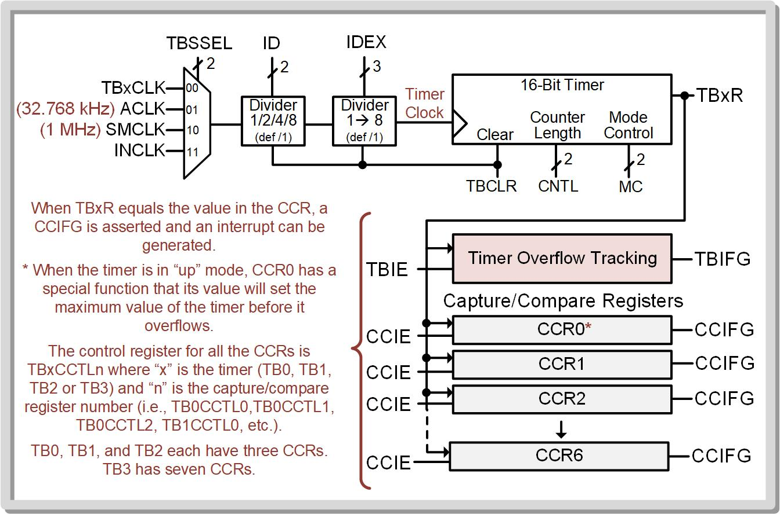
Ch. 12: Introduction to Timers
Timer Compares on the MSP430FR2355
Timer Compare – triggers an event when the main timer value equals a value stored in one of the MSP430’s capture/compare registers (CCR).
12.3 Timer Compares on the MSP430FR2355

Slide 58
Ch. 12: Introduction to Timers
Timer Compares on the MSP430FR2355
Timer compare – triggers an event when the main timer value equals a value stored in one of the MSP430’s capture/compare registers (CCR).
TB0, TB1, and TB2 each have three (3) CCRs.
i.e., Timer0_B3
i.e., Timer1_B3
i.e., Timer2_B3
12.3 Timer Compares on the MSP430FR2355

Slide 59
Ch. 12: Introduction to Timers
Timer Compares on the MSP430FR2355
Timer compare – triggers an event when the main timer value equals a value stored in one of the MSP430’s capture/compare registers (CCR).
TB3 has seven (7) CCRs.
i.e., Timer3_B7
12.3 Timer Compares on the MSP430FR2355

Slide 60
Ch. 12: Introduction to Timers
Timer Compares on the MSP430FR2355
When TBxR and CCR values match, the CCR will assert a flag (CCIFG) and can trigger an interrupt if enabled.
Each CCR has its own local enable (CCIE) and flag (CCIFG)
=
=
12.3 Timer Compares on the MSP430FR2355

Slide 61
Ch. 12: Introduction to Timers
Timer Compares on the MSP430FR2355
The interrupt sources share the two interrupt vectors for each timer.
12.3 Timer Compares on the MSP430FR2355

Slide 62
Ch. 12: Introduction to Timers
Timer Compares on the MSP430FR2355
The interrupt sources share the two interrupt vectors for each timer.
Notice the CCR0 flags have dedicated vectors?
Notice the CCR0 flags have dedicated vectors?
Notice the CCR0 flags have dedicated vectors?
Notice the CCR0 flags have dedicated vectors?
12.3 Timer Compares on the MSP430FR2355

Slide 63
Ch. 12: Introduction to Timers
Timer Compares on the MSP430FR2355
The interrupt sources share the two interrupt vectors for each timer.
They have “special” behavior when in UP mode.
They have “special” behavior when in UP mode.
They have “special” behavior when in UP mode.
Notice the CCR0 flags have dedicated vectors?
They have “special” behavior when in UP mode.
Notice the CCR0 flags have dedicated vectors?
Notice the CCR0 flags have dedicated vectors?
Notice the CCR0 flags have dedicated vectors?
12.3 Timer Compares on the MSP430FR2355

Slide 64
Ch. 12: Introduction to Timers
Timer Compares on the MSP430FR2355
When in UP mode, CCR0 sets the maximum overflow count value for the timer.
12.3 Timer Compares on the MSP430FR2355

Slide 65
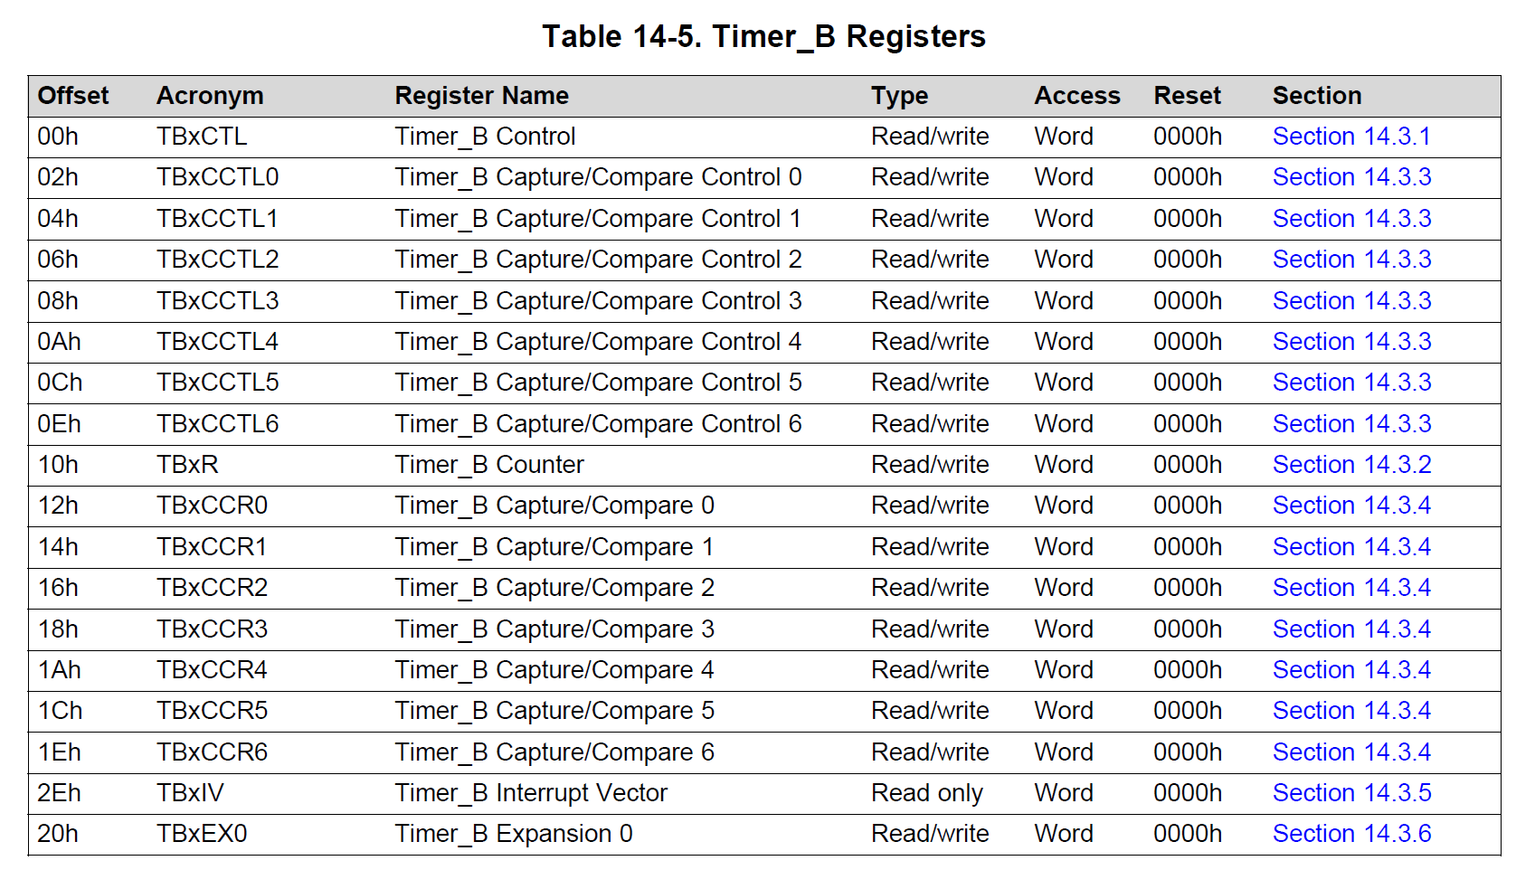
Ch. 12: Introduction to Timers
Timer Compares on the MSP430FR2355
Each CCR has its own register to hold its compare value – Timer B Capture/Compare Register (TBxCCRn)
12.3 Timer Compares on the MSP430FR2355

Slide 66
Ch. 12: Introduction to Timers
Timer Compares on the MSP430FR2355
Each CCR has its own control register called Timer B Capture/Compare Control Register (TBxCCTLn)
12.3 Timer Compares on the MSP430FR2355

Slide 67
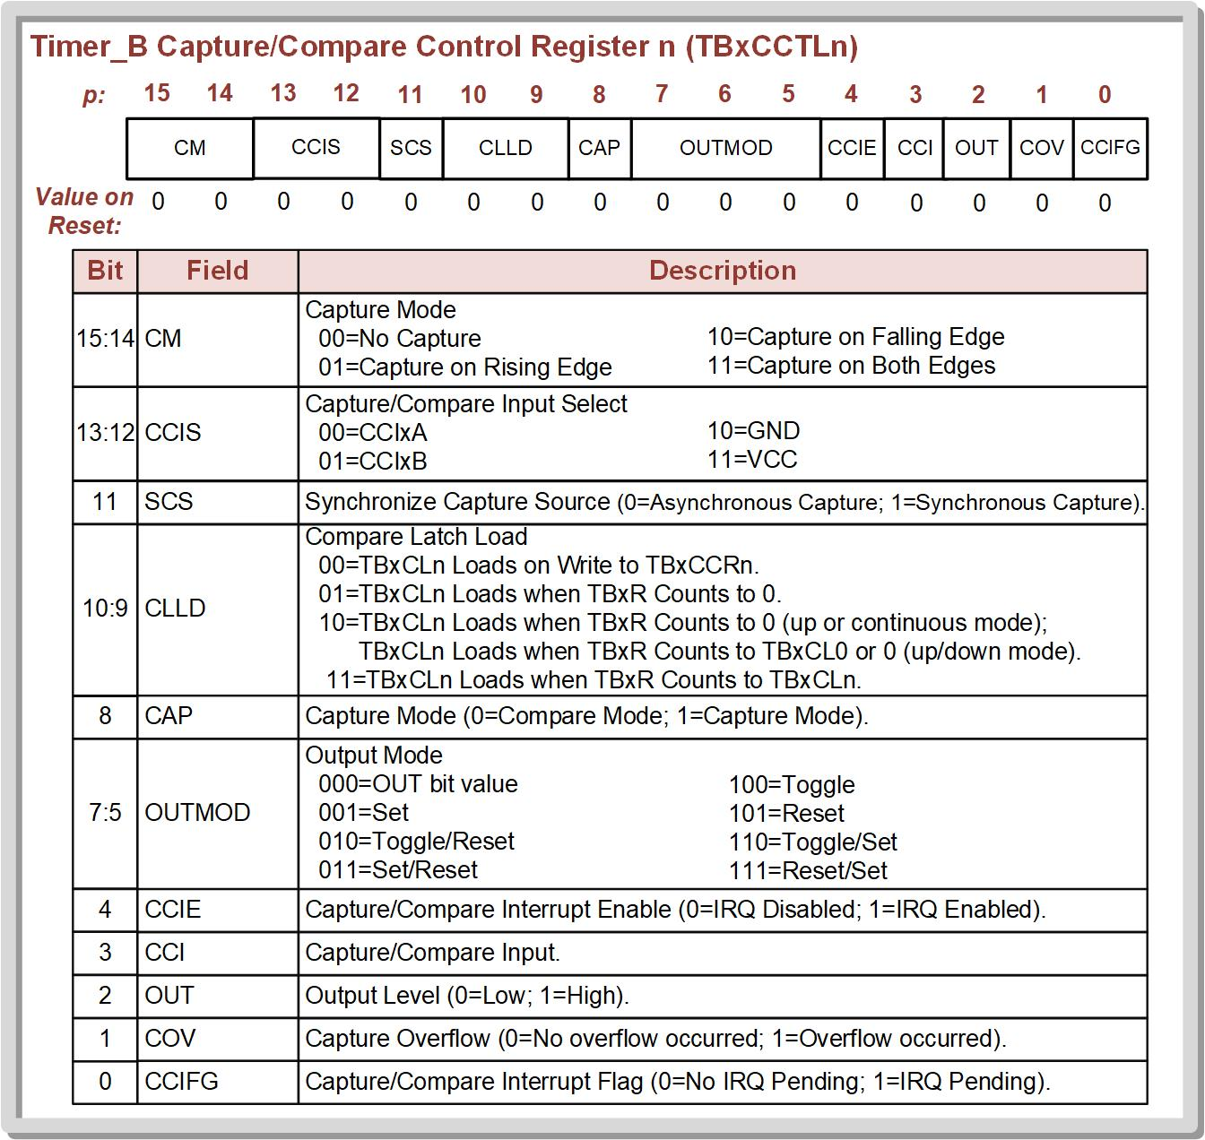
Ch. 12: Introduction to Timers
Timer Compares on the MSP430FR2355
12.3 Timer Compares on the MSP430FR2355

Slide 68
Ch. 12: Introduction to Timers
Timer Compares on the MSP430FR2355
Timer_B x Interrupt Vector Register (TBxIV) – holds the same code that represents the highest CCR IRG that has occurred.
12.3 Timer Compares on the MSP430FR2355

Slide 69
Embedded Systems Design
Chapter 12: Introduction to Timers
12.3 Timer Compares on the MSP430FR2355
www.youtube.com/c/DigitalLogicProgramming_LaMeres
Brock J. LaMeres, Ph.D.

Slide 70
Embedded Systems Design
Chapter 12: Introduction to Timers
12.3 Timer Compares on the MSP430FR2355 – Example: Toggling LED1 every 0.5 seconds using CCR
Brock J. LaMeres, Ph.D.

Slide 71
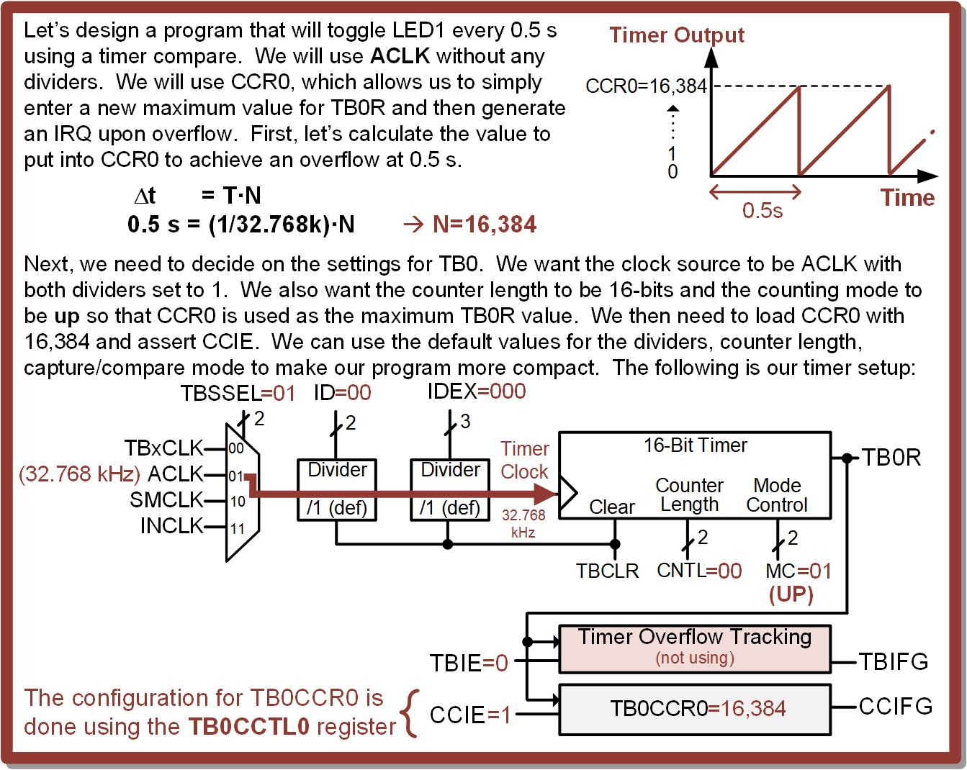
Ch. 12: Introduction to Timers
Ex: Toggling LED1 Using a CCR0 Compare
12.3 Timer Compares on the MSP430FR2355

Slide 72
Ch. 12: Introduction to Timers
Ex: Toggling LED1 Using a CCR0 Compare
Step 1: Create a new Empty Assembly-only CCS project titled:
Asm_Timers_Compare_CCR0
Step 2: Type in the following code into the main.asm file where the comments say “Main loop here.”
Image Courtesy of https://neodem.wp.horizon.ac.uk/
Image Courtesy of
Recording Connection of Canada
Image Courtesy of
Recording Connection of Canada
Image Courtesy of
Recording Connection of Canada
Image Courtesy of
Recording Connection of Canada
12.2 Timer Overflows on the MSP430FR2355

Slide 73
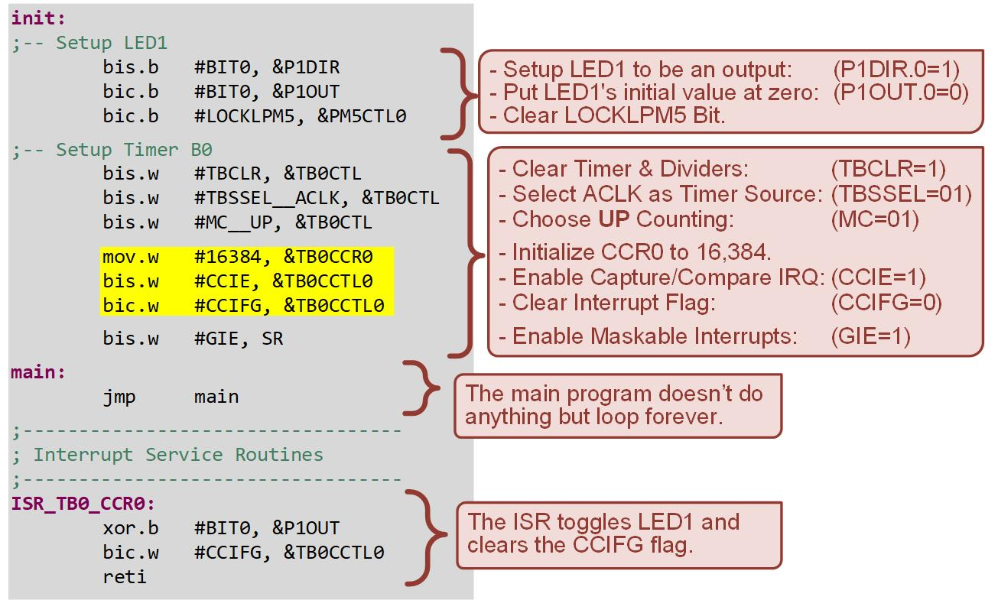
Ch. 12: Introduction to Timers
Ex: Toggling LED1 Using a CCR0 Compare
12.2 Timer Overflows on the MSP430FR2355

Slide 74
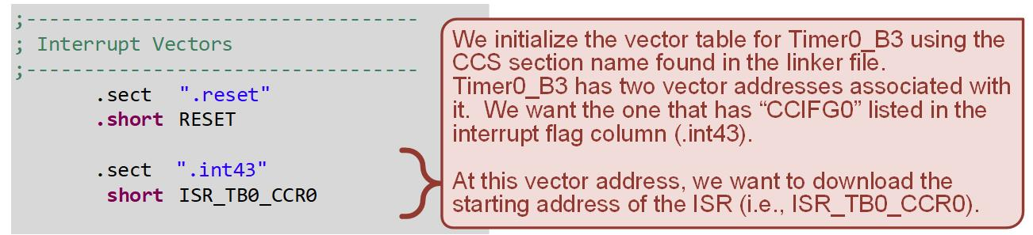
Ch. 12: Introduction to Timers
Ex: Toggling LED1 Using a CCR0 Compare
Step 3: Debug your program and run it. You will see LED1 toggle on and off every 0.5 seconds.
12.2 Timer Overflows on the MSP430FR2355

Slide 75
Embedded Systems Design
Chapter 12: Introduction to Timers
12.3 Timer Compares on the MSP430FR2355 – Example: Toggling LED1 every 0.5 seconds using CCR
www.youtube.com/c/DigitalLogicProgramming_LaMeres
Brock J. LaMeres, Ph.D.

Slide 76
Embedded Systems Design
Chapter 12: Introduction to Timers
12.4 Creating Pulse Width Modulated Signals using Timer Compares
Brock J. LaMeres, Ph.D.

Slide 77
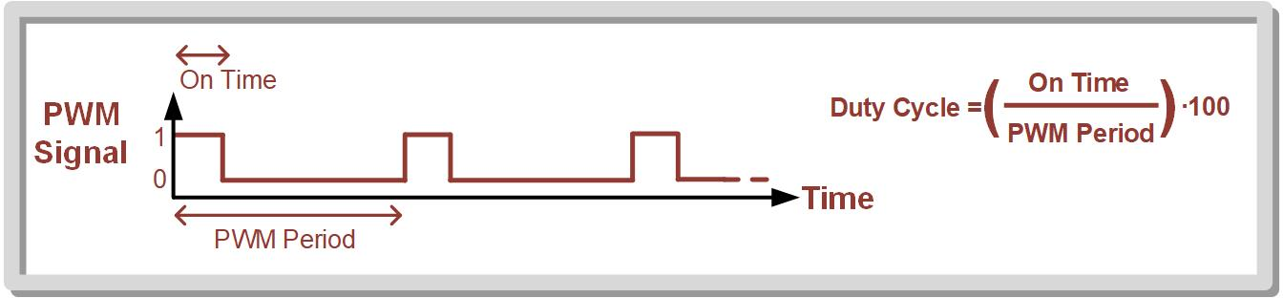
Ch. 12: Introduction to Timers
Creating Pulse Width Modulated Signals using Timer Compares
Pulse Width Modulated (PWM) signal – a popular type of electrical signal that can be generated with timer compares.
PWM signals are used for motor control, dimming LEDs, and to communicate information.
On Time – the amount of time that a periodic signal is high
Duty cycle – the percentage of the period that is high.
12.4 Creating Pulse Width Modulated Signals using Timer Compares

Slide 78
Ch. 12: Introduction to Timers
Creating Pulse Width Modulated Signals using Timer Compares
A PWM can be created using the Timer_B system by setting up two compare registers – CCR0 and CCR1.
CCR0 – holds the count value corresponding to the period of the PWM signal.
CCR1 - holds the count value corresponding to the amount of on time that is desired.
12.4 Creating Pulse Width Modulated Signals using Timer Compares

Slide 79
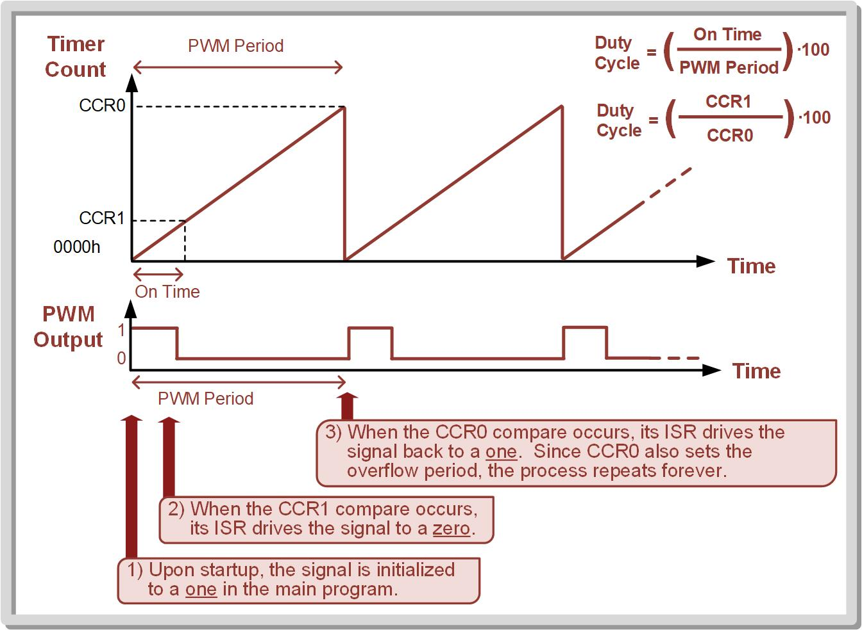
Ch. 12: Introduction to Timers
Creating Pulse Width Modulated Signals using Timer Compares
12.4 Creating Pulse Width Modulated Signals using Timer Compares

Slide 80
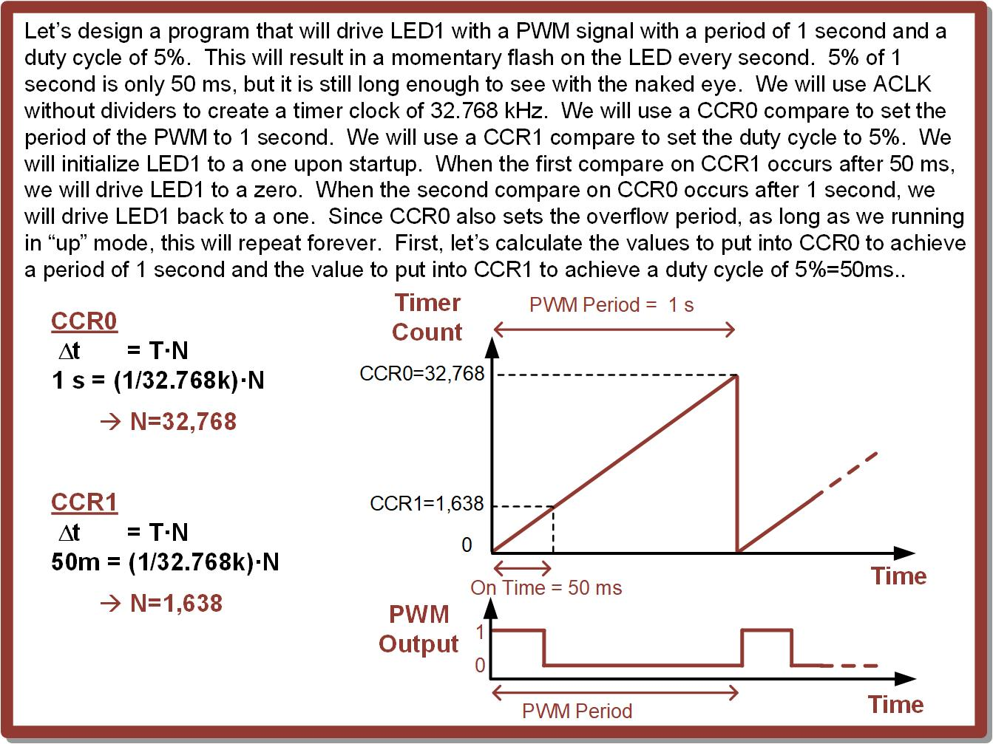
Ch. 12: Introduction to Timers
Ex: Flashing LED1 with a 5% Duty Cycle PWM Using Multiple Compares
12.4 Creating Pulse Width Modulated Signals using Timer Compares

Slide 81
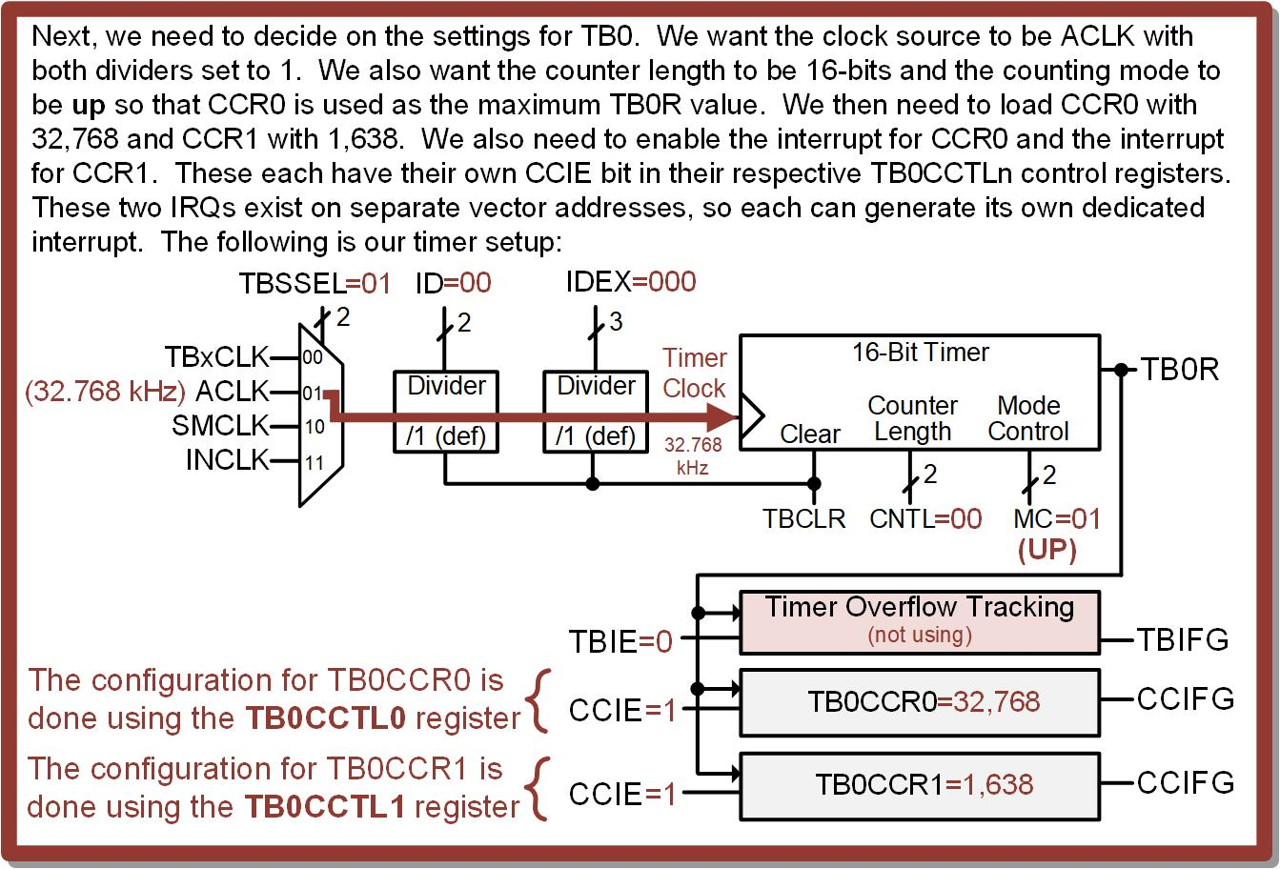
Ch. 12: Introduction to Timers
Ex: Flashing LED1 with a 5% Duty Cycle PWM Using Multiple Compares
12.4 Creating Pulse Width Modulated Signals using Timer Compares

Slide 82
Ch. 12: Introduction to Timers
Ex: Flashing LED1 with a 5% Duty Cycle PWM Using Multiple Compares
12.2 Timer Overflows on the MSP430FR2355

Slide 83
Ch. 12: Introduction to Timers
Ex: Flashing LED1 with a 5% Duty Cycle PWM Using Multiple Compares
Step 1: Create a new Empty Assembly-only CCS project titled:
Asm_Timers_Compare_CCR1_n_CCR0_PWM
Step 2: Type in the following code into the main.asm file where the comments say “Main loop here.”
Image Courtesy of https://neodem.wp.horizon.ac.uk/
Image Courtesy of
Recording Connection of Canada
Image Courtesy of
Recording Connection of Canada
Image Courtesy of
Recording Connection of Canada
Image Courtesy of
Recording Connection of Canada
12.2 Timer Overflows on the MSP430FR2355

Slide 84
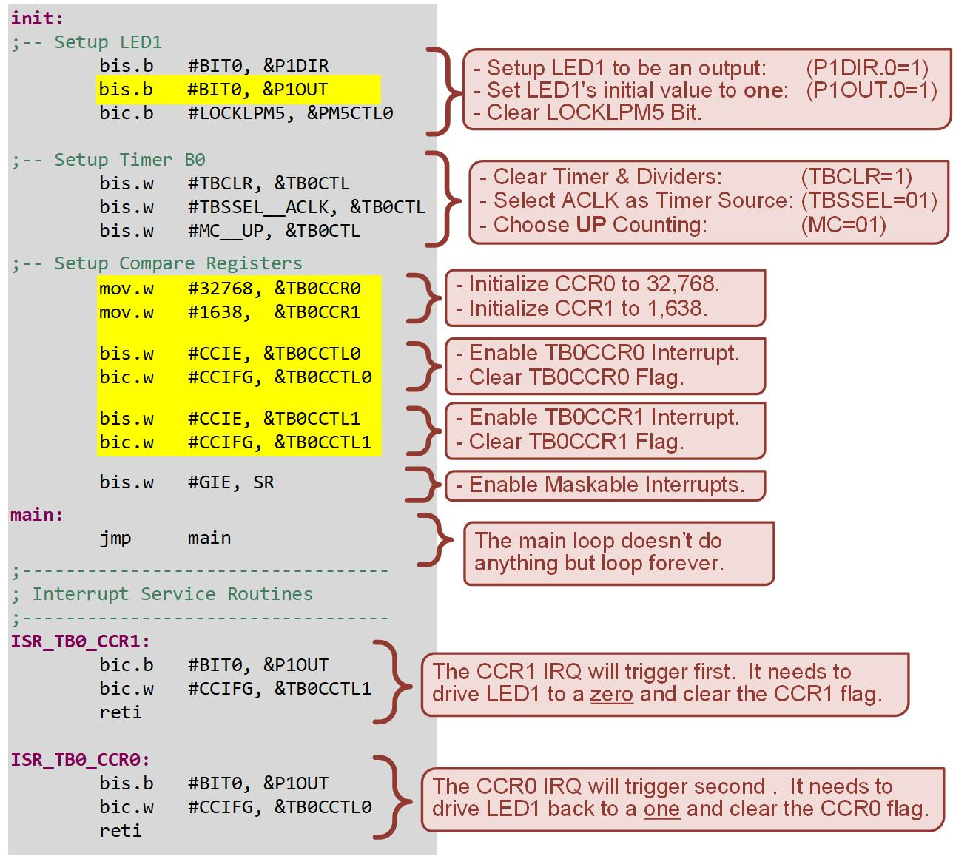
Ch. 12: Introduction to Timers
Ex: Flashing LED1 with a 5% Duty Cycle PWM Using Multiple Compares
12.2 Timer Overflows on the MSP430FR2355

Slide 85
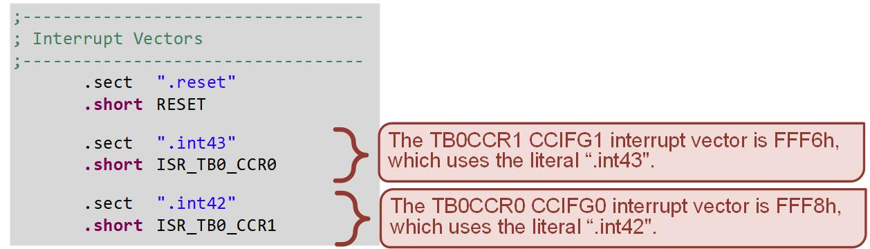
Ch. 12: Introduction to Timers
Ex: Flashing LED1 with a 5% Duty Cycle PWM Using Multiple Compares
Step 3: Debug your program and run it. You will see LED1 flash briefy every 1 second.
12.2 Timer Overflows on the MSP430FR2355

Slide 86
Embedded Systems Design
Chapter 12: Introduction to Timers
12.4 Creating Pulse Width Modulated Signals using Timer Compares
www.youtube.com/c/DigitalLogicProgramming_LaMeres
Brock J. LaMeres, Ph.D.

Slide 87
Embedded Systems Design
Chapter 12: Introduction to Timers
12.5 Timer Captures on the MSP430FR2355
Brock J. LaMeres, Ph.D.

Slide 88
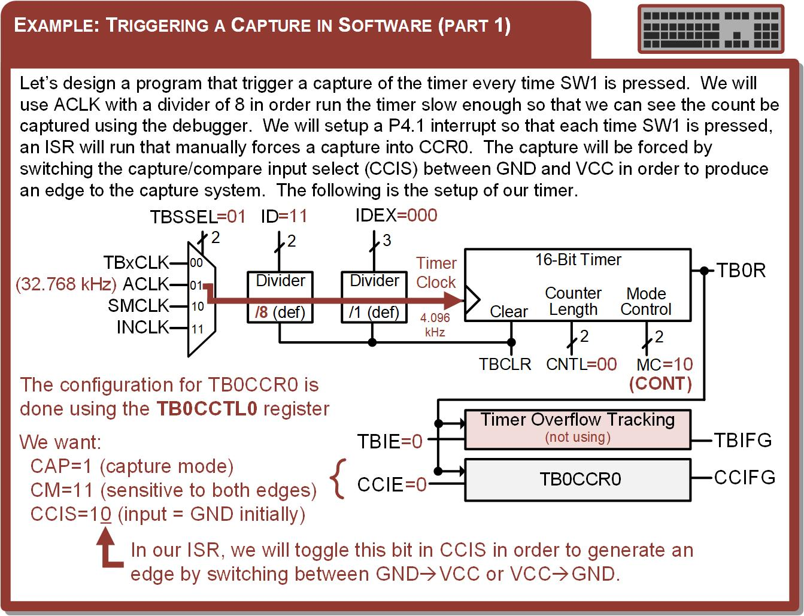
Ch. 12: Introduction to Timers
Timer Captures on the MSP430FR2355
12.5 Timer Captures on the MSP430FR2355

Slide 89
Ch. 12: Introduction to Timers
Timer Captures on the MSP430FR2355
Timer Capture – store the current value of the timer into one of the capture/compare registers upon a triggering event.
This function can be used to measure time between events, both externally or internally.
The capture mode is selected with CAP=1 in the TBxCCTLn register.
A transition on the internal signal Capture/Compare Input (CCI) will cause a capture.
Image Courtesy of https://neodem.wp.horizon.ac.uk/
Image Courtesy of
Recording Connection of Canada
Image Courtesy of
Recording Connection of Canada
Image Courtesy of
Recording Connection of Canada
Image Courtesy of
Recording Connection of Canada
Image Courtesy of
Recording Connection of Canada
12.5 Timer Captures on the MSP430FR2355

Slide 90
Ch. 12: Introduction to Timers
Timer Captures on the MSP430FR2355
The edge polarity on CCI that triggers the capture is dictated by the Capture Mode (CM) bits within TBxCCTLn and supports, rising edge, falling edge, or both edge sensitivity.
The source for CCI is dictated by the Capture/Compare Input Select (CCIS) bits within TBxCCTLn.
A capture event can also be triggered by software by manually creating an edge on CCI.
Image Courtesy of https://neodem.wp.horizon.ac.uk/
Image Courtesy of
Recording Connection of Canada
Image Courtesy of
Recording Connection of Canada
Image Courtesy of
Recording Connection of Canada
Image Courtesy of
Recording Connection of Canada
Image Courtesy of
Recording Connection of Canada
12.5 Timer Captures on the MSP430FR2355

Slide 91
Ch. 12: Introduction to Timers
Timer Captures on the MSP430FR2355
12.5 Timer Captures on the MSP430FR2355

Slide 92
Ch. 12: Introduction to Timers
Timer Captures on the MSP430FR2355
12.5 Timer Captures on the MSP430FR2355

Slide 93
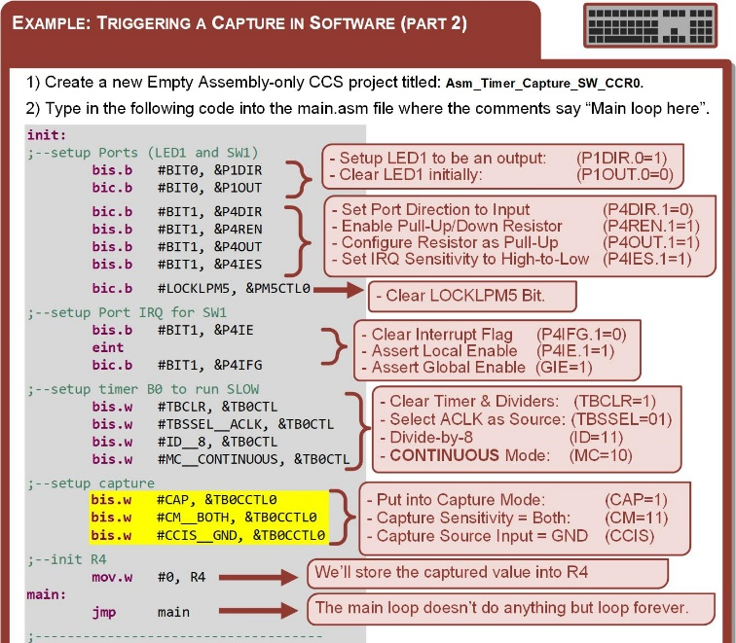
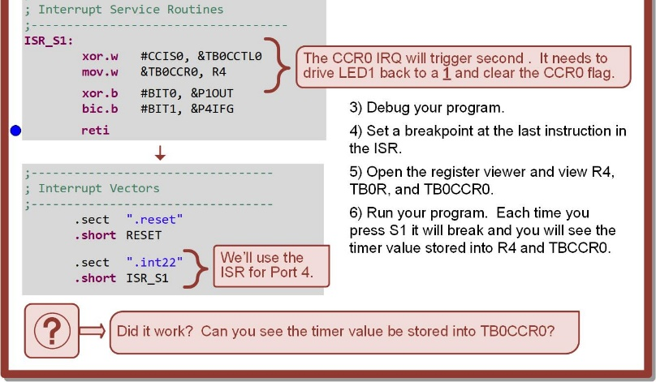
Ch. 12: Introduction to Timers
Timer Captures on the MSP430FR2355
12.5 Timer Captures on the MSP430FR2355

Slide 94
Embedded Systems Design
Chapter 12: Introduction to Timers
12.5 Timer Captures on the MSP430FR2355
www.youtube.com/c/DigitalLogicProgramming_LaMeres
Brock J. LaMeres, Ph.D.

